Slide 1
Machine learning with F#
Yousry Mohamed

Slide 2
Agenda
ML Intro
Linear Regression Background
Demo in F#
Demo in Azure ML

Slide 3
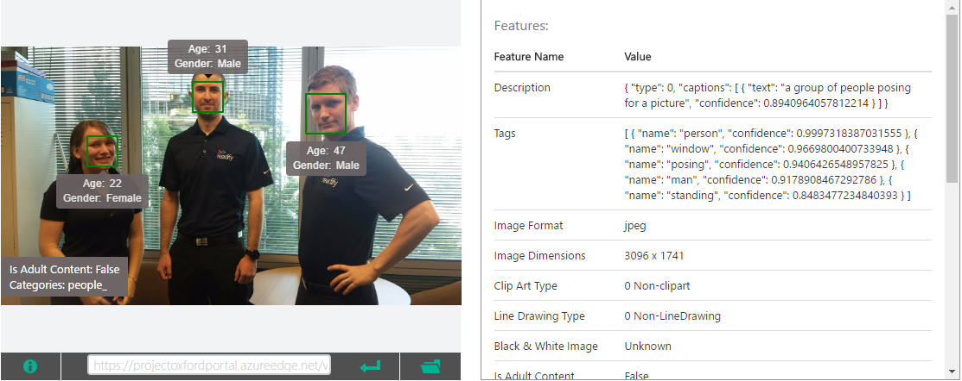
What is ML
Field of study that gives computers the ability to learn without being explicitly programmed

Slide 4
ML general workflow
Training/Historical Data
Learning Algorithm
Unseen Input x
Function h (Model)
Output y

Slide 5
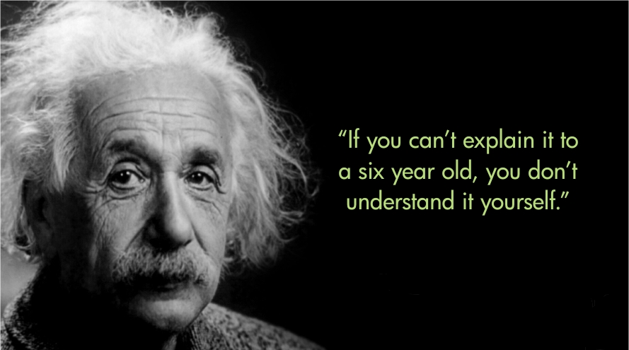
Why to rebuild the wheel ( sort of )
Focus on abstracting the algorithm ideas
Don’t worry about edge cases and implementation robustness

Slide 6
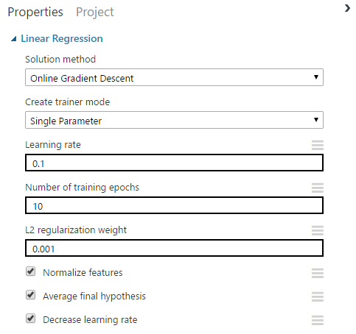
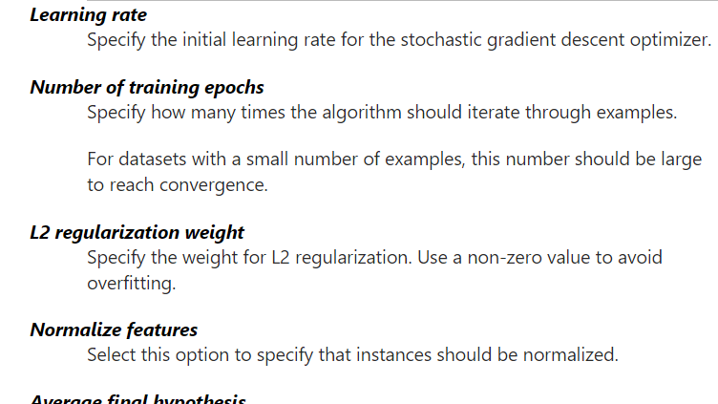
Better use of ready made tools & APIs

Slide 7

Why F#
Experiment with data and hypothesis quickly
Concise representation of ideas (less ceremony)
Type providers allows to plug into extra goodness like charting, R integration, Hadoop and OData etc.

Slide 8
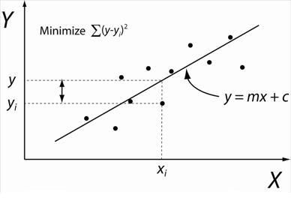
Linear Regression
Regression is a machine learning algorithm used to predict a numeric outcome. Linear regression attempts to establish a linear relationship between independent variables and dependent variable, that is also numeric.

Slide 9
Why Linear Regression
Very simple algorithm, can fit in a 30 mins session ☺.
Has numerous applications
Forecast sales/crop production/# of claims/resales prices/crime rate etc.
Acts a basis for classification using logistic regression
It can also model non linear relationships using feature engineering
Allows model interpretation which is crucial in certain domains like credit risk analysis
Simpler algorithms often outperform far more complex methods

Slide 10
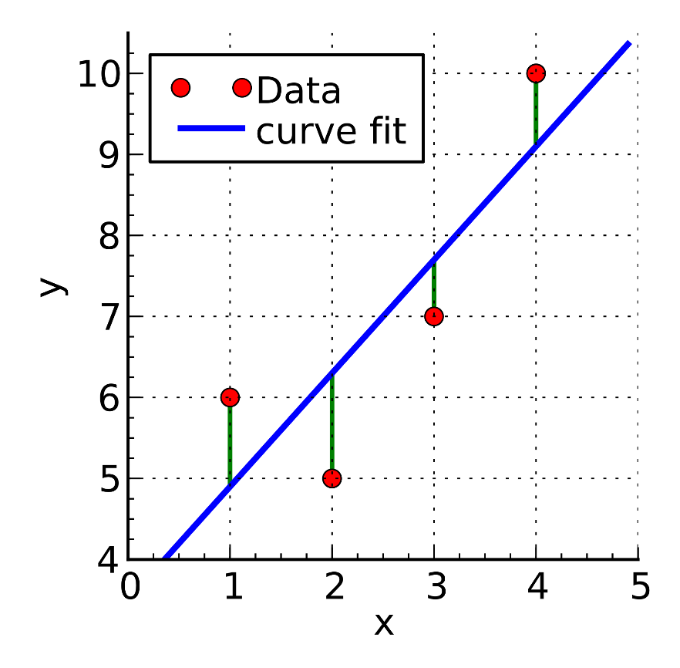

Linear Regression Objective (applies to any other ML algorithm)
Fine tuning model parameters to achieve a fit with minimum errors and maximum generalization

Slide 11

Demo

Slide 12
Key takeaways
It is fun
Better usage of ready made APIs
Another tool in your toolbox

Slide 13
Resources
Coursera ML course
Expert F# book in our library
Pluralsight : F# course by Liam
Free eBook : An Introduction to statistical learning
Book : Predictive Analytics with Microsoft Azure Machine Learning
Azure ML online docs

